Slide 1
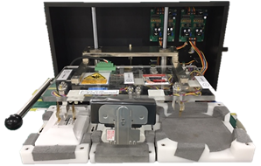
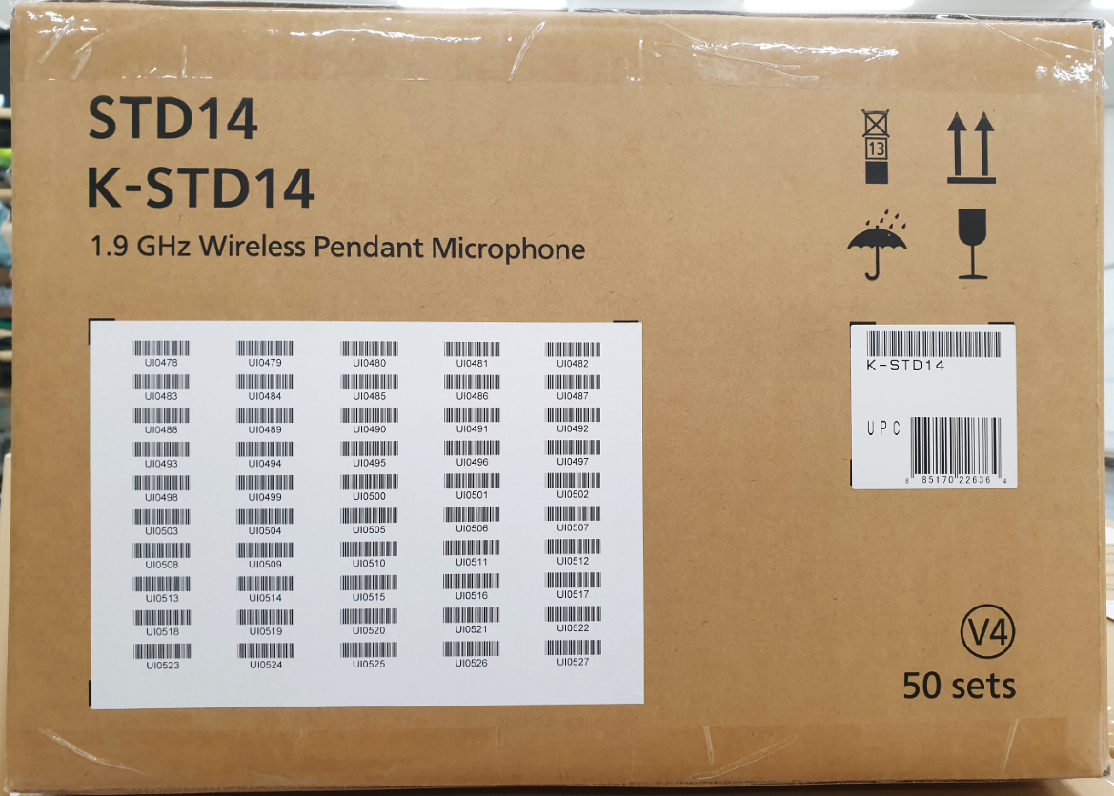
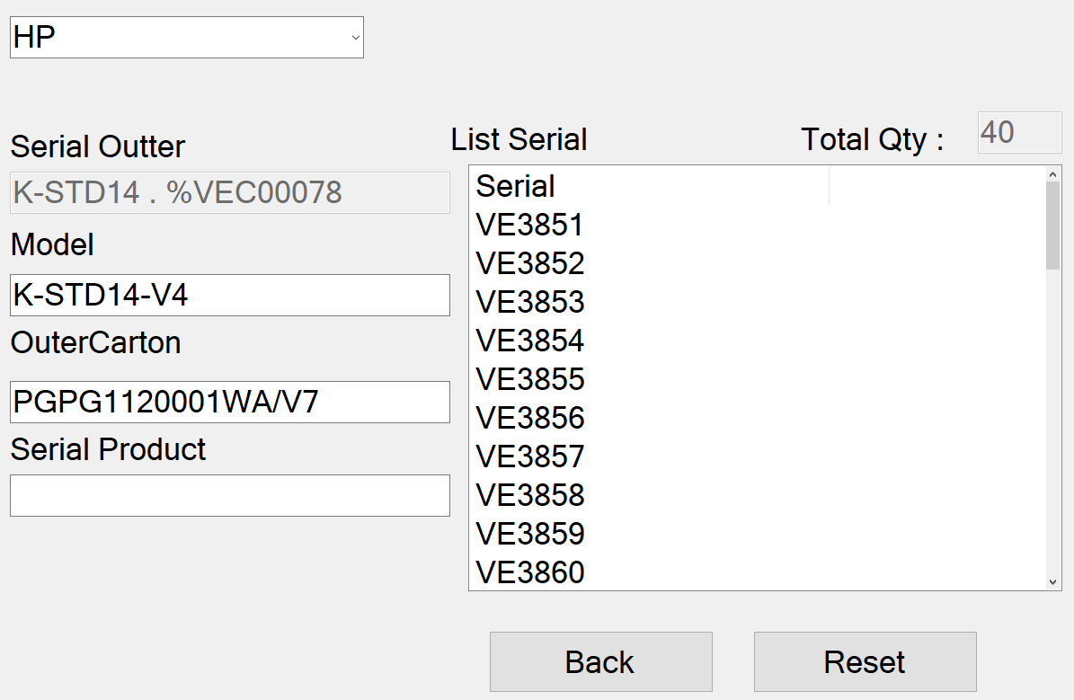




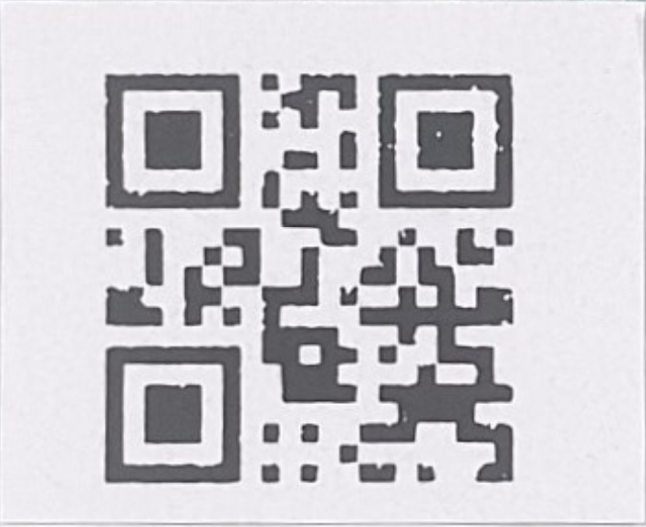
Input serial product into outer carton for category sound biz
Developer: Nguyen Nhu Minh
Apply: Apr.2022
Expn: 0
Save time: 35h/y
◆Before
◆ After
Weight check
New cate
Total outer carton
S/N Link
OK
5kg
Shipping set up
Case NG item→ Affect to quality
Detect error in case NG item→ Stop line
Add new function merge serial inner into serial outer on Shrink system
IT,PE support
Currently :
Take long time when product NG IT, PE check log file shipment and process problem.
Take time: 1serial / 5 minutes
~day: 12 serial x 5 = 60 minutes
~30 hours/month ~ 35 hours/year.
Improve :
Make new function on Shrink system input serial product into outer.
No stop line and finished carton. User control Item NG and combine them with serial outer has been setting mater.
Save Time support for IT
Total: 35h/y

Slide 2
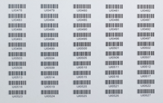


ADD MORE QR CODE LABEL FOR SHIPMENT STATION
Developer:
Apply: Apr.2022
Expn: 0
Save time:
◆Before
◆ After
In line production: Weight check process will scan one by one serial & link to QR code
In Shipment Station : Confirm Serial No.
One by one scan serial → Loss time
Weight check not control quantity serial inner on carton box
In Shipment Station : Confirm Serial No. by reading QR code only.
Currently :
Manual data excel to print barcode serial.(easy mistake)
Weight check not detect when scan wrong serial inner of another one carton. (Affect to quality )
When shipment station: Confirm serial one by one → Very loss time (250s/box)
Plan : 28,800 box/ Year → Loss : 2K hour ~ 4K USD
Improve :
Printing label automatic generate and control. Easy manage operation and history. Ensure quality
Weight check auto compare serial inner with serial outer.
→ Traceability Weight check process
When shipment station: Confirm serial No.by reading QR code only
→Traceability Pallet ID process
Plan : 28,800 box/ Year → Loss cost: ~ 0.08K USD
SAVE COST: 3.9K USD/ Year

Slide 3
ADD MORE QR CODE LABEL FOR SHIPMENT STATION
No.3
BEFORE
AFTER
In Shipment Station: Confirm Serial No.
One by one scan serial
In Shipment Station: Confirm Serial No.
by reading QR code only.
In line production: Weight check process will scan one by one serial & link to QR code
In Shipment Station : Confirm Serial No.
One by one scan serial → Loss time
In Shipment Station : Confirm Serial No. by reading QR code only.
Current Situation :
Model: All model Sound Bz: When shipment station: Confirm serial one by one → Very loss time (250s/box)
Improvement Point :
Model: All model Sound Bz: When Shipment Station:
Confirm Serial No.by reading QR code only.
→ Save Time: 245S/ box
Detail: Refer slide below

Slide 4
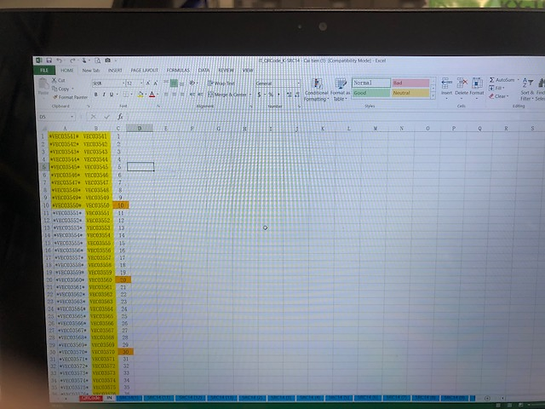
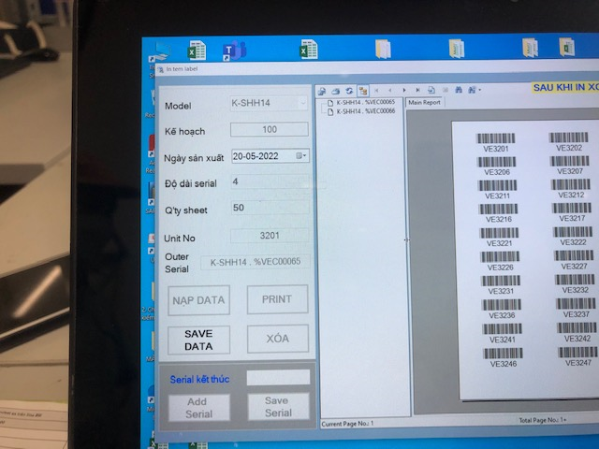
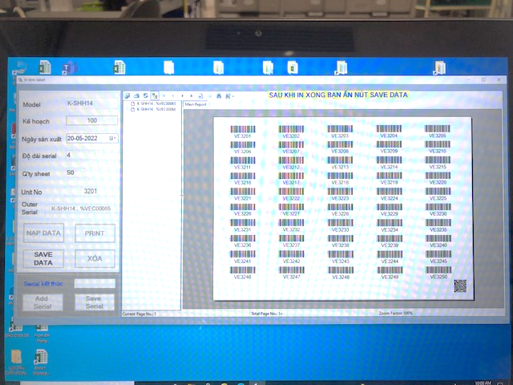
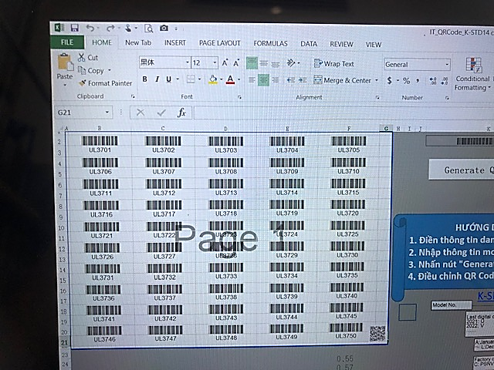
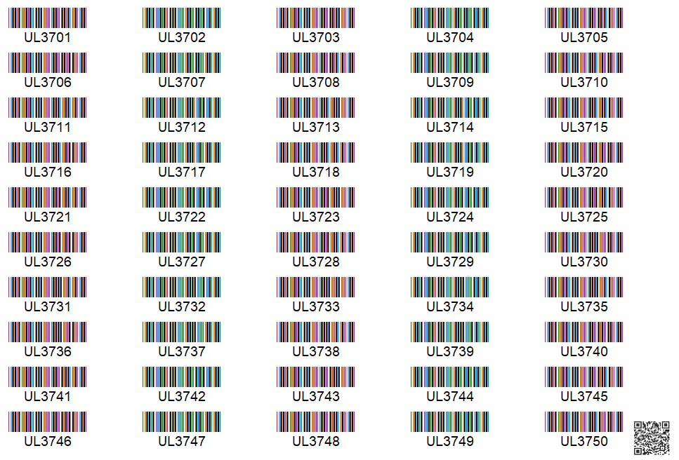
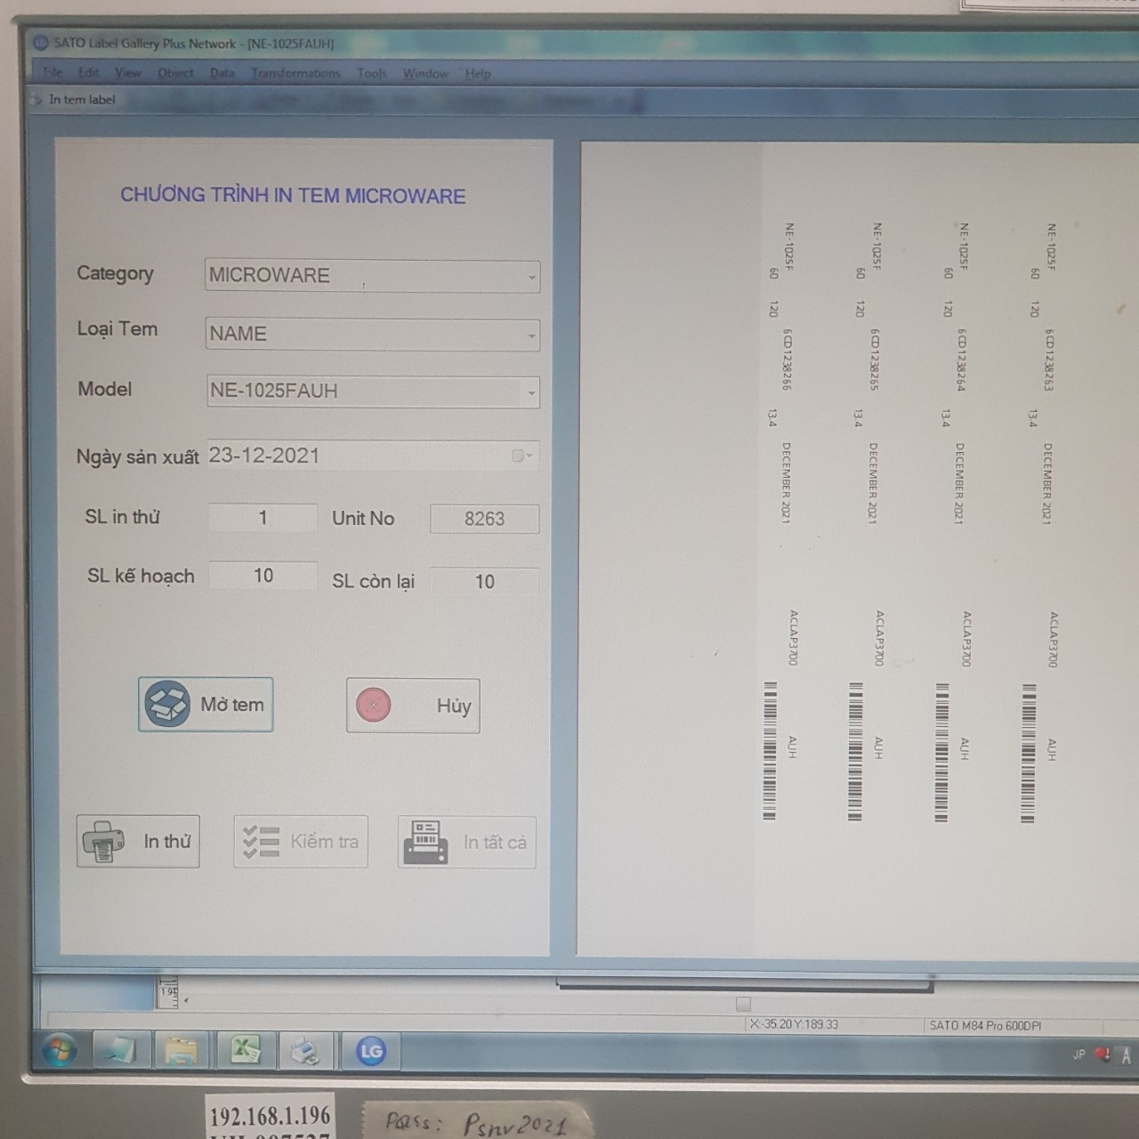
AUTOMATION PRINTING OUTER LABEL SB
1/1
Get serial number continue model by model from application.
Developer: NGUYEN THI THANH HOA
Apply: Jan-2022
Expn: 0
Ensure quality
◆Before
◆ After
Step 1: In put serial No into excel file
Step 2: Create Barcode by Macro then printing
Choose Model
➔ Get serial number continue
Manual input serial number
Separate file by model ( Total : 10 files )
Manual control serial number
Automation get serial number continue when choose model
Manual control serial number.
Easy to make mistake, wrong serial.
Automation get serial number continue.
Ensure quality.
Set up parameter
Year – month-date
of production date
Serial number
Year – month of production date : automation
Serial number : automation number continue
Notes:
Next theme, this is database daily checking improved by development team.

Slide 5
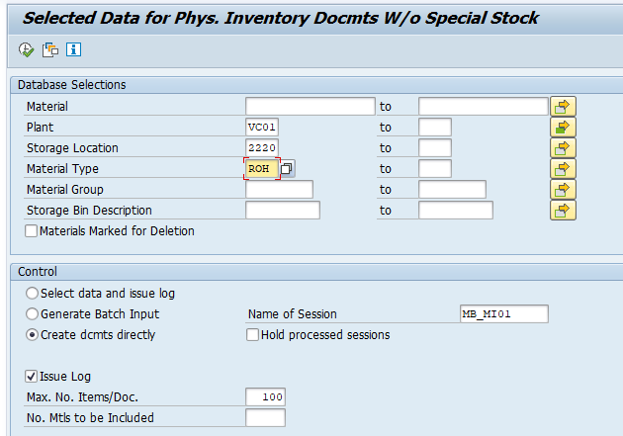
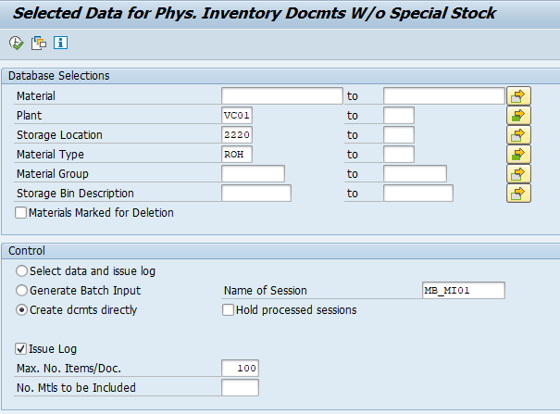
Reduce time to support user inventory
1/1
Reduce time to create physical inventory number for user monthly
Developer: SAP team
Apply: Apr.2022
Expn: 0
Save time: 56h/y
◆Before
◆ After
~ 900 storage location in SAP
Input each material type each time → 3 type = 3 execution time
Input all material type one time
Take time to execute for each material type
Reduce time to execute for all material type
Execution no. time: ~ 200 time (each type)
For all type = 200 time x 3 = 600 time
→ Take time: 600 time x 0.7 min = 420min
Execution no. time: ~ 200 time
For all type = 200 time x 1 = 200 time
Take time: 200 time x 0.7 min = 140 min
Save time: 280 min/month = 56h/y

Slide 6


REDUCE service FEE
Remove software using for work from home
Developer: Vu Duc Chinh
Apply: Apr 2022
Expense: 0
Save time: 1.376USD/month
◆ Before
◆ After
WFH
WFH
Install
Uninstall
Smart Ras soft [Connect server]
G-EDR soft
[Prevent attack outside]
Smart Ras soft [Connect server]
G-EDR soft
[Prevent attack outside]
8 $/PC/Month
8 $/PC/Month
0 $/PC/Month
0 $/PC/Month
Expense : 16 $ x 86 pcs =1.376 USD/month
Expense : 0 USD/month
Lost: 1.376USD/month
Save: 1.376USD/month
Notes:
Khi covid xảy ra mọi người mang máy về làm việc ở nhà phải cài phần mềm Smart Ras kết nối mạng để kết nối đến mạng công ty
Đồng thời phải cài phần mềm kiểm soát và ngăn chặn tấn công từ bên ngoài
Sau khi hết Covid mọi người quay trở lại công ty sẽ không cần đến phần mềm trên nữa => tiết kiệm dc 1.376USD/month

Slide 7
ADD MORE QR CODE LABEL FOR SHIPMENT STATION
No.3
BEFORE
AFTER
In Shipment Station: Confirm Serial No.
One by one scan serial
In Shipment Station: Confirm Serial No.
by reading QR code only.
In line production: Weight check process will scan one by one serial & link to QR code
In Shipment Station : Confirm Serial No.
One by one scan serial → Loss time
In Shipment Station : Confirm Serial No. by reading QR code only.
Current Situation :
Model: All model Sound Bz: When shipment station: Confirm serial one by one → Very loss time (250s/box)
Improvement Point :
Model: All model Sound Bz: When Shipment Station:
Confirm Serial No.by reading QR code only.
→ Save Time: 245S/ box
Detail: Refer slide below

Slide 8



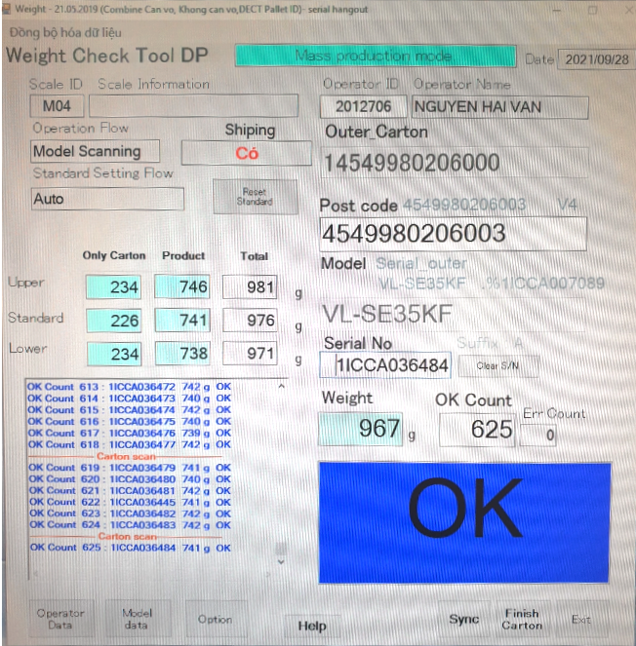
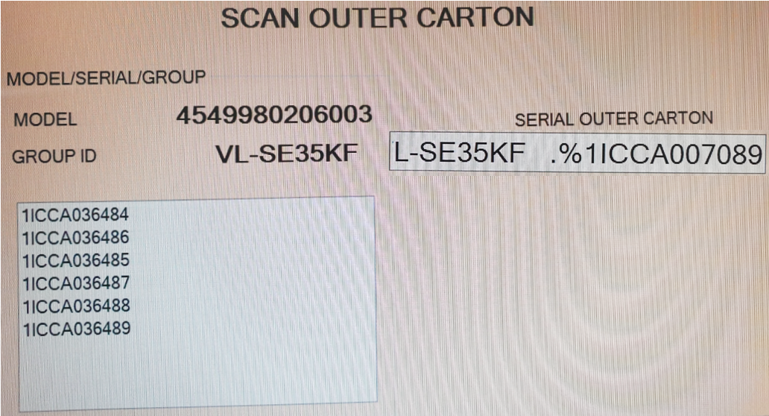
Follow chart Process & Purpose and effective.
Production – Weight check
Pallet ID - Process
SCS - process
Scan one by one serial & Link to QR code
Server
Server
Server
Weigh check
Scan QR
code only
Make
Pallet ID
Scan Pallet ID before shipment
Shipping
To market
Purpose
Purpose
Purpose
Weigh check for all serial No & save to server
Reading QR code of outer carton & save to Sever → Traceability Weight check process
Scan serial No one by one & Link to QR code outer carton
Make Pallet ID For Control serial No of each pallet →Can traceability history
Reading QR code of outer carton before shipment & save to server →Traceability Pallet ID process
Control serial No of each pallet before Shipment →Can traceability history
BEFORE:
Confirm serial one by one → Loss time (250s/box)
Plan : 28,800 box/ Year → Loss : 2K hour ~ 4K USD
BEFORE:
Confirm serial one by one → Loss time (250s/box)
Plan : 28,800 box/ Year → Loss : 2K hour ~ 4K USD
Request Modify weigh check
Register QR code
Register Serial No.
In Shipment Station:
Confirm Serial No.
by reading QR code only.
AFTER
Confirm Serial No.by reading QR code only.→ Time: 5S/ box
Plan : 28,800 box/ Year → Loss cost: ~ 0.08K USD
SAVE COST: 3.9K USD/ Year
AFTER
Confirm Serial No.by reading QR code only.→ Time: 5S/ box
Plan : 28,800 box/ Year → Loss cost: ~ 0.08K USD
SAVE COST: 3.9K USD/ Year
Auto display all Serial No. inside of box
Read
QR code
Auto Compare Serial inner & outer box
Total Save cost: 7.8K USD / Year

